Slide 1

Young people on the global stage
Gender and Opportunity
MORE WOMEN #ELLEFeminism - YouTube
www.tidegloballearning.net
Notes:
Teacher note:
Video link: https://www.youtube.com/watch?v=GEKo22ryWxM
Alternative video – young Australians discuss the gender pay gap
http://www.dailymail.co.uk/femail/article-3481363/International-Women-s-Day-2016-video-shows-girls-receive-pocket-money-brothers-highlight-gender-pay-gap.html#v-3465772669513517976

Slide 2
The Gender Gap Slide Set
Our Aims and Objectives
To compare these issues with countries around the world.
To raise awareness about Gender Issues in the UK.
To increase knowledge about how poverty and sustainability affects gender issues.
www.tidegloballearning.net

Slide 3
Looking at statistics
What do you notice?
How might we explain this?
What does this tell us about gender and opportunity ?
www.tidegloballearning.net

Slide 4
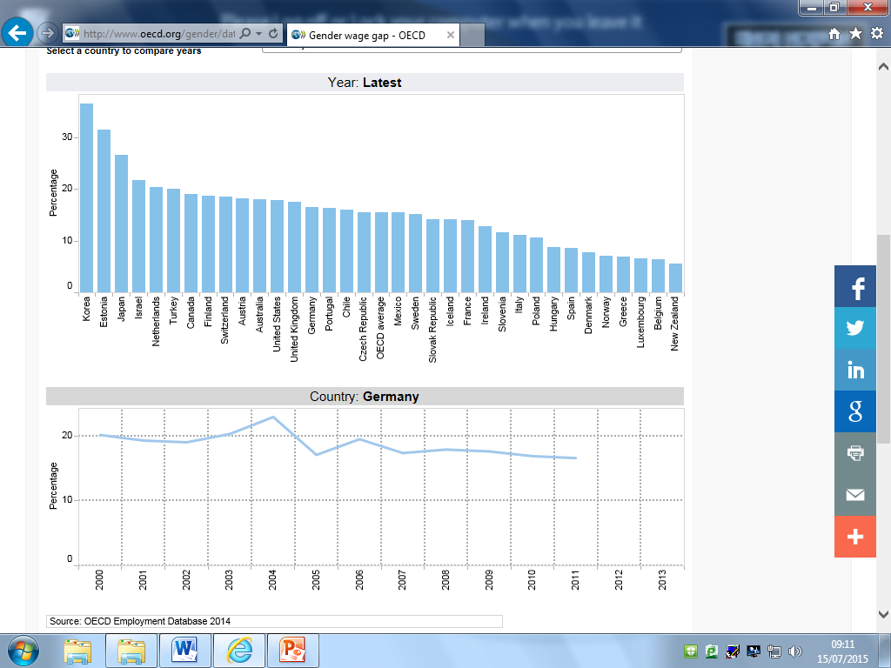
Statistics
www.tidegloballearning.net
Notes:
Teacher notes:
This graph shows the pay gap as a percentage: how much men’s wages were higher compared to women's wages around the world.
Print out the slides of graphs etc and ask – what do you notice? How might we explain this? What does this tell us about gender and opportunity?

Slide 5
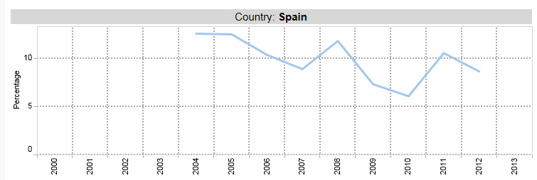
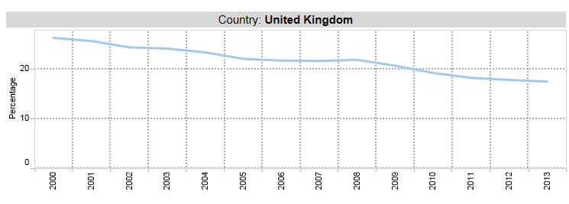
Statistics
www.tidegloballearning.net
Notes:
Teacher notes:
This graph shows how the percentage difference has changed over time in the UK, Spain and Kenya.

Slide 6
Statistics
The rules in Kenya on equal pay and equality and work state that men and women should be given equal pay for equal jobs.
The Kenya law clearly states that there shall be no form of discrimination in employment.
“Eliminating all forms of discrimination at the work place, including pay, guarantees both women and men equality of opportunity in employment, as well as equal pay for work of equal value.”
www.tidegloballearning.net

Slide 7
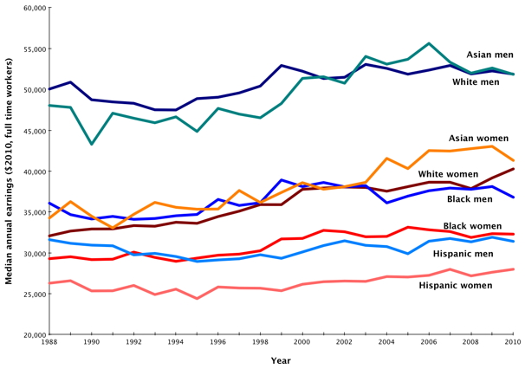
Statistics
This graph shows the annual earnings (in dollars) for people of different gender and race in the US:
www.tidegloballearning.net

Slide 8
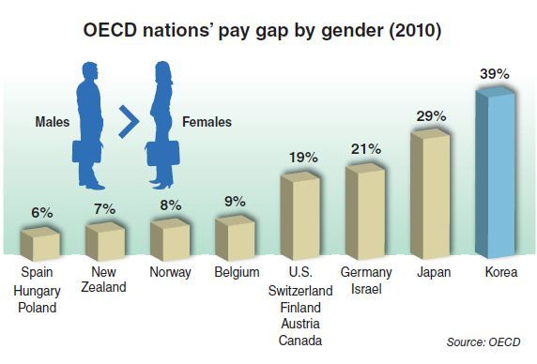
Statistics
www.tidegloballearning.net

Slide 9
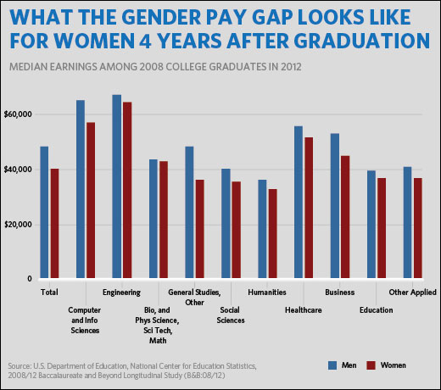
Statistics (USA)

Slide 10
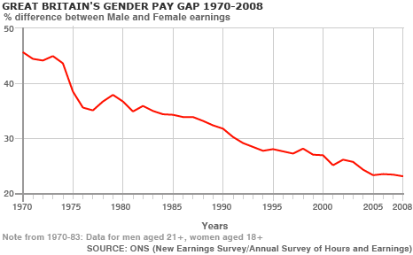
Statistics

Slide 11
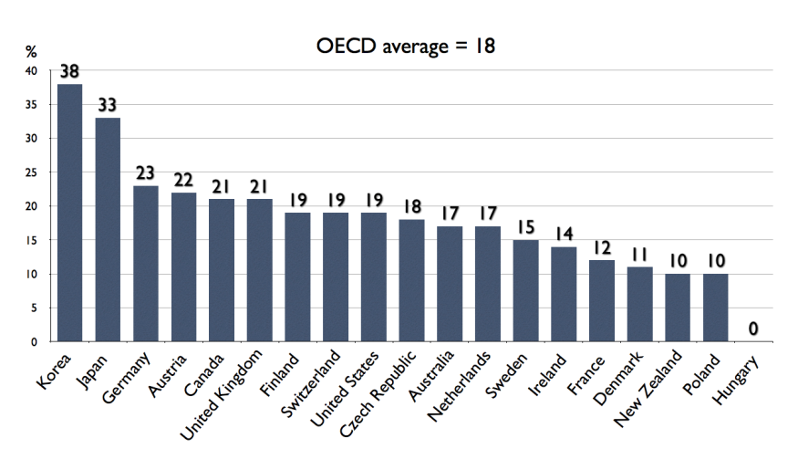
Statistics
www.tidegloballearning.net

Slide 12
How does it make you feel?
Activity 1. Discuss…
Do you think this happens in reality?
What would you do in this situation?
www.tidegloballearning.net
Notes:
Teacher notes:
This is where you could give out the scenario cards

Slide 13
Because I am a Girl - I'll take it from here | Plan International
www.tidegloballearning.net
Notes:
Teacher notes:
Taking its example from Malawi, this video from an international NGO shows the great things and difficulties about being a girl, and what can be done about them.
Link: https://plan-international.org/because-i-am-girl-ill-take-it-here

Slide 14





Slogan Activity
If you were to make a slogan to do with promoting gender equality, what would it be?
Examples:
www.tidegloballearning.net

Slide 15
Think about what you can do
Short term action:
Long term action:
Other ways you can help:
-
-
-
-
www.tidegloballearning.net

Slide 16






Young people on the global stage
Slides compiled by the Young Leaders group at Kings Norton Girls’ School, Birmingham
Project partners are Tide~ global learning and University of Exeter in the UK,
FERE-CECA Madrid in Spain, A Rocha Kenya in Kenya and TANGO in The Gambia.
This document has been produced with the financial assistance of the European Union. The contents of this publication are the sole responsibility of the project partners and can under no circumstances be regarded as reflecting the position of the European Union.

